Slide 1

Toning (not Tuning) Our Worship
1 Thes. 5:16-18

Slide 2
Toning (not Tuning) Our Worship
Have a clear picture of what the future would look like
Start with small changes that lead to lifestyle changes
Recruit encourages to help you stay on track and meet your goal

Slide 3


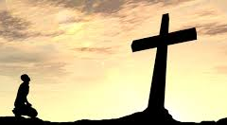

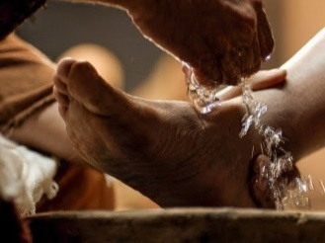
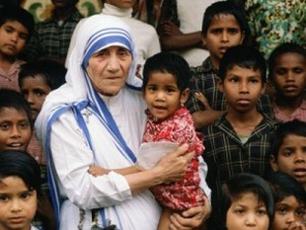


Working Toward Worship
Definition: Worship is our response to God’s revelation

Slide 4

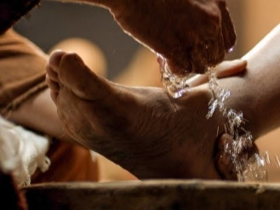
Working Toward Worship
“I appeal to you therefore, brothers, by the mercies of God, to present your bodies as living sacrifices, holy and acceptable to God, which is your spiritual act of worship.” (Rom. 12:1)

Slide 5

Working Toward Worship
“Do not be conformed to this world, but be transformed by the renewal of your mind, that by testing you may discern what is the will of God, what is good and acceptable and perfect.” (Rom. 12:2)

Slide 6
Worshiping Community/
Worshiping Individual
“… for this is God’s will in Christ Jesus for you” (1 Thes. 5:18b)

Slide 7
Worshiping Community/
Worshiping Individual
“Rejoice always,” (v. 16)
Joy: an overflowing expression from a deep fullness in life.

Slide 8
Worshiping Community/
Worshiping Individual
“Pray without ceasing,” (v. 17)
“God’s listening creates a vacuum to our soul. We respond with prayer, and in the process we learn that God loves us. God initiates prayer through His listening.”
~ David Hansen (The Art of Pastoring)

Slide 9
Worshiping Community/
Worshiping Individual
“Give thanks in all circumstances,” (v. 17)
Thanksgiving is the act of according rightful gratitude to the one who gives all good gifts.

Slide 10
Spiritual Exercise
“Rejoice Always”
“Pray Without Ceasing”
“Give Thanks in All Circumstances”
For the next _________ months I will focus on _____________________.

Slide 11
Toning (not Tuning) Our Worship
Have a clear picture of what the future would look like
Start with small changes that lead to lifestyle changes
Recruit encourages to help you stay on track and meet your goal

