Slide 1


Slide 2
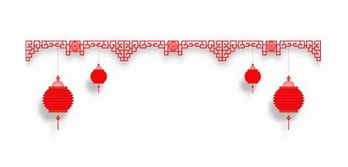
红与新年
Red & New Year

Slide 3
红色 = 生命？ Red = Life?
因为活物的生命是在血中。我把这血赐给你们，可以在坛上为你们的生命赎罪，因血里有生命，所以能赎罪。
For the life of a creature is in the blood, and I have given it to you to make atonement for yourselves on the altar; it is the blood that makes atonement for one's life.
利未纪 Leviticus 17:11 NIV

Slide 4
红色 = 生命？ Red = Life?
因为活物的生命是在血中。我把这血赐给你们，可以在坛上为你们的生命赎罪，因血里有生命，所以能赎罪。
For the life of a creature is in the blood, and I have given it to you to make atonement for yourselves on the altar; it is the blood that makes atonement for one's life.
利未纪 Leviticus 17:11 NIV

Slide 5
耶稣说，我实实在在地告诉你们，你们若不吃人子的肉，不喝人子的血，就没有生命在你们里面。 吃我肉，喝我血的人就有永生。在末日我要叫他复活。我的肉真是可吃的，我的血真是可喝的。吃我肉喝我血的人，常在我里面，我也常在他里面。
Jesus said to them, "Very truly I tell you, unless you eat the flesh of the Son of Man and drink his blood, you have no life in you. Whoever eats my flesh and drinks my blood has eternal life, and I will raise them up at the last day. For my flesh is real food and my blood is real drink. Whoever eats my flesh and drinks my blood remains in me, and I in them.
約 翰 福 音 John 6:53-56 NIV

Slide 6
耶稣说，我实实在在地告诉你们，你们若不吃人子的肉，不喝人子的血，就没有生命在你们里面。 吃我肉，喝我血的人就有永生。在末日我要叫他复活。我的肉真是可吃的，我的血真是可喝的。吃我肉喝我血的人，常在我里面，我也常在他里面。
Jesus said to them, "Very truly I tell you, unless you eat the flesh of the Son of Man and drink his blood, you have no life in you. Whoever eats my flesh and drinks my blood has eternal life, and I will raise them up at the last day. For my flesh is real food and my blood is real drink. Whoever eats my flesh and drinks my blood remains in me, and I in them.
約 翰 福 音 John 6:53-56 NIV

Slide 7
摘要 Summary
红色代表生命, 成长证明生命。
Red Represent Life, Growth Prove Life.
希望永远在前方, 因此要一直向前看。
Hope Always Lies Ahead, Therefore Look Forward.
唯独通过基督, 我们才能有永恒的生命和希望。
Through Christ Alone, We Have Eternal Life & Hope.

