Slide 1
在巴比伦的河边 By The River Of Babylon
谷心镇华人基督教会 2019 年 4 月 28 日
Chinese Christian church of Corvallis 4/28/2019

Slide 2
诗篇 Psalms 137 : 1 - 3
1我们曾在巴比伦的河边坐下，一追想锡安就哭了。
2 我们把琴挂在那里的柳树上；
3 因为在那里，掳掠我们的要我们唱歌，抢夺我们的要我们作乐，说：给我们唱一首锡安歌罢
1 By the rivers of Babylon we sat and wept when we remembered Zion.
2 There on the poplars we hung our harps,
3 for there our captors asked us for songs, our tormentors demanded songs of joy; they said "Sing us one of the songs of Zion!

Slide 3
诗篇 Psalms 137 : 3 - 6
4 我们怎能在外邦唱耶和华的歌呢？
5 耶路撒冷啊，我若忘记你，情愿我的右手忘记技巧！
6 我若不记念你，若不看耶路撒冷过於我所最喜乐的，情愿我的舌头贴於上膛！
4 How can we sing the songs of the Lord while in a foreign land?
5 If I forget you, Jerusalem, may my right hand forget its skill.
6 May my tongue cling to the roof of my mouth if I do not remember you, if I do not consider Jerusalem my highest joy.

Slide 4
底格里斯河 Tigris River
Picture By Lora Taylor

Slide 5
伯拉大河 Euphrates
Picture By Lora Taylor

Slide 6
古巴比伦空中花园 Hanging Garden of Babylon
Picture from www.wonders-of-the-world.net

Slide 7
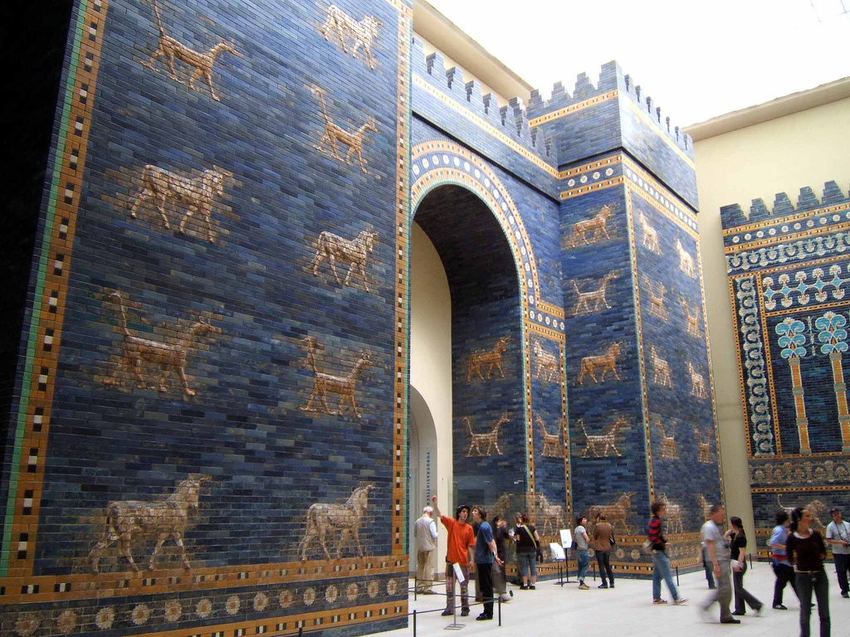
伊什塔尔城门 Ishtar Gate
By Rictor Norton https://commons.wikimedia.org/wiki/File:Ishtar_Gate_at_Berlin_Museum.jpg
By Einsamer Schütze https://commons.wikimedia.org/wiki/File:Vorderasiatisches_Museum_Berlin_003_(cropped).jpg

Slide 8
古巴比伦城 City of Babylon
From https://www.realmofhistory.com/2019/03/07/babylon-history-reconstruction/

Slide 9
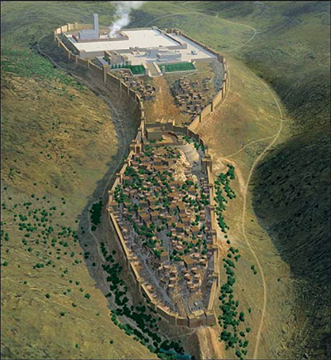
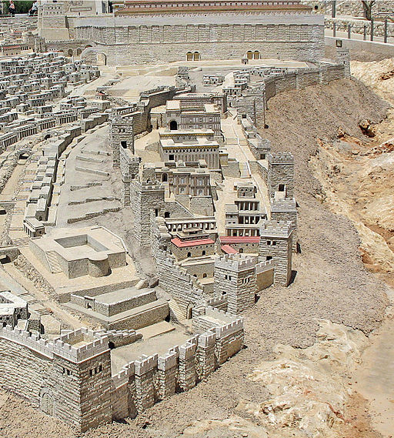
锡安
Zion
大卫城
City of
David
耶路撒冷
Jerusalem
From https://christinprophecy.org
By Ariely https://commons.wikimedia.org/wiki/File:City_of_David.jpg

Slide 10
诗篇 Psalms 137 : 1
1我们曾在巴比伦的河边坐下，一追想锡安就哭了。
1 By the rivers of Babylon we sat and wept when we remembered Zion.

Slide 11
诗篇 Psalms 137 : 2 - 3
2 我们把琴挂在那里的柳树上；
3 因为在那里，掳掠我们的要我们唱歌，抢夺我们的要我们作乐，说：给我们唱一首锡安歌罢
2 There on the poplars we hung our harps,
3 for there our captors asked us for songs, our tormentors demanded songs of joy; they said "Sing us one of the songs of Zion!

Slide 12
站在巴比伦的河边 By the river of Babylon
站在世界的繁华和我们的信仰中间
Stand between the world and the faith
只剩下最后一点点和神的联系
Remaining the last bond with God
要夺去我们这剩下仅有的
To be snatched away

Slide 13
诗篇 Psalms 137 : 4 - 6
4 我们怎能在外邦唱耶和华的歌呢？
5 耶路撒冷啊，我若忘记你，情愿我的右手忘记技巧！
6 我若不记念你，若不看耶路撒冷过於我所最喜乐的，情愿我的舌头贴於上膛！
4 How can we sing the songs of the Lord while in a foreign land?
5 If I forget you, Jerusalem, may my right hand forget its skill.
6 May my tongue cling to the roof of my mouth if I do not remember you, if I do not consider Jerusalem my highest joy.

Slide 14
诗篇 126
1当耶和华将那些被掳的带回锡安的时候，我们好像做梦的人。
2我们满口喜笑，满舌欢呼的时候，外邦中就有人说，耶和华为他们行了大事。
3耶和华果然为我们行了大事，我们就欢喜。
4耶和华阿，求你使我们被掳的人归回，好像南地的河水复流。
5流泪撒种的，必欢呼收割。
6那带种流泪出去的，必要欢欢乐乐地带禾捆回来。
1 When the Lord restored the fortunes of Zion, we were like those who dreamed.
2 Our mouths were filled with laughter, our tongues with songs of joy. Then it was said among the nations, “The Lord has done great things for them.”
3 The Lord has done great things for us, and we are filled with joy.
4 Restore our fortunes, Lord, like streams in the Negev.
5 Those who sow with tears will reap with songs of joy.
6 Those who go out weeping, carrying seed to sow, will return with songs of joy, carrying sheaves with them.

Slide 15
我们怎能在外邦唱耶和华的歌呢？ How can we sing the songs of the Lord while in a foreign land? 我们怎能在异乡交出我们的心呢？ How can we sell our hearts while in a foreign land?

