Slide 1
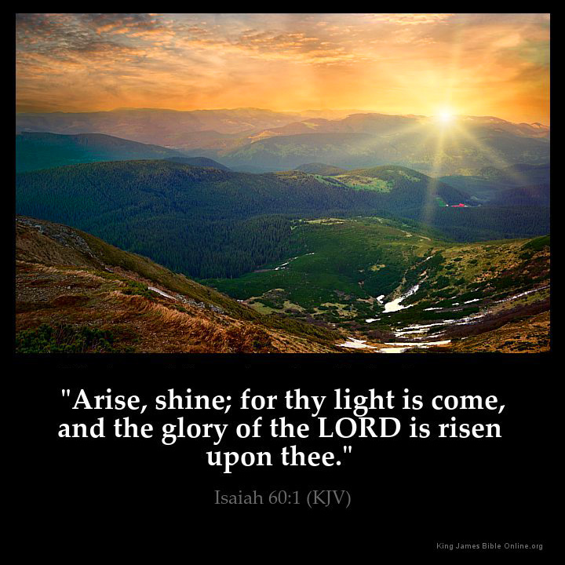
以賽亞書60:1「興起，發光！因為你的光已經來到！耶和華的榮耀發現照耀你。」

Slide 2
末日榮耀的教會 Glory church in the End time
健康的教會 Healthy church
等候新郎的教會 Church that waiting for the groom
彼此相愛的教會 Church that loves each other
站在真理上的教會 Church standing on the truth
勇敢、會打仗、不怕苦、不怕死的教會 Church that is brave, able to fight, unafraid of suffering and death

Slide 3
A. 健康的教會 Healthy church
認識三一真神 – 聖父、聖子、聖靈 (太28:19)
Knows Trinity - the Father, the Son and the Holy Spirit (Matthew 28:19)
認識聖經 – 神的話 (提後3:16-17) Knows God’s words (2Timothy3:16-17)
認識自己在基督裡是誰 Knows who am I in Christ
①神兒女 (約1:12) God’s Child (John 1:12)
②新造的人 (林後5:17) The new creation (2 Corinthians 5:17)
認識神給祂兒女的產業和權柄 Knows God's industry and authority to His children
①有永生 (約3:16) Have eternal life (John 3:16)
②與主同作王 (啟20:6) Reign with him (Revelation 20:6)
認識神永恆的計畫 (創世紀 → 啟示錄) Knows God's Eternal Plan (Genesis→ Revelation)
- 起初神創造了天地…新天新地 In the beginning God created…a new heaven and a new earth

Slide 4
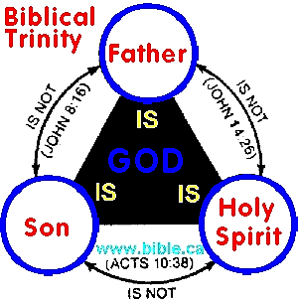
認識三一真神 – 聖父、聖子、聖靈

Slide 5

Perfect Heavenly Father 完美的聖父

Slide 6
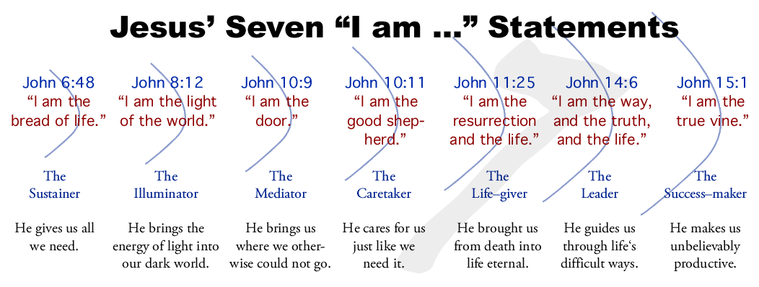
Jesus seven I AM in the book of JOHN 約翰福音中有7處耶穌說〝我是…〞

Slide 7
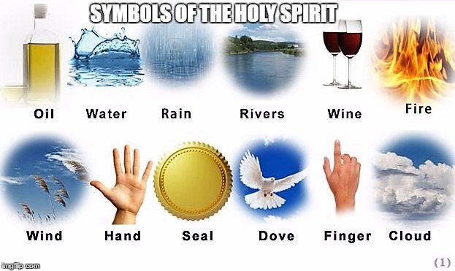
Symbols of Holy Spirit 聖靈的象徵

Slide 8
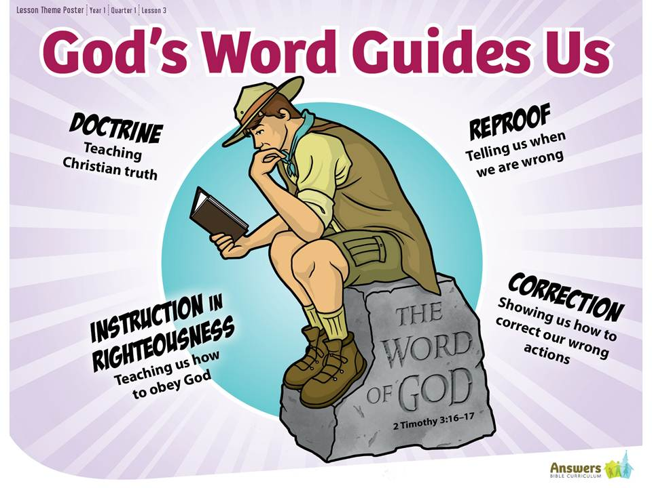
Word of God (2 Tim 3:16-17) 神的話 (提後3:16-17)

Slide 9

詩 119:105「你的話是我腳前的燈，是我路上的光。」

Slide 10
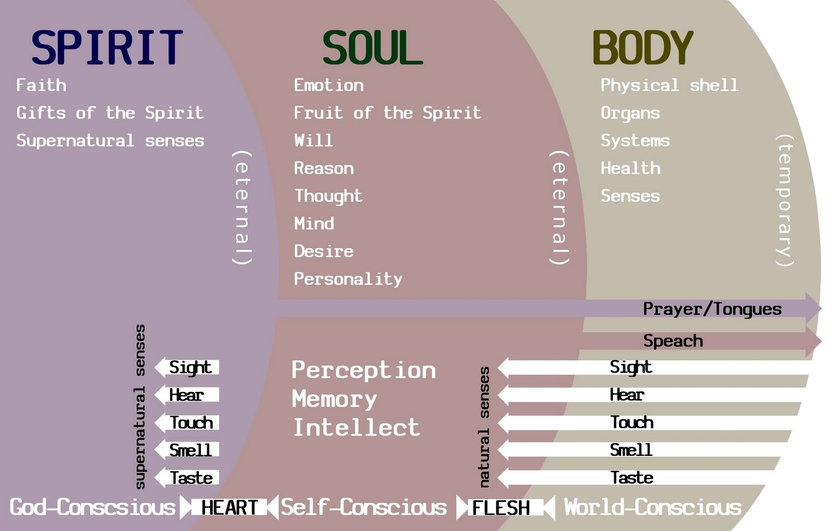
spirit, soul and body 靈魂體

Slide 11
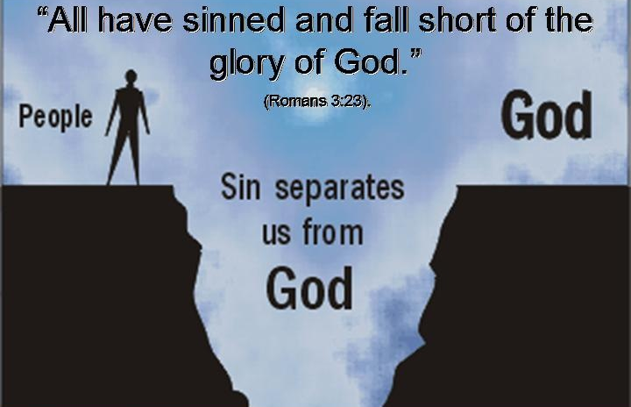
羅馬書 3:23「因為世人都犯了罪，虧缺了神的榮耀」

Slide 12
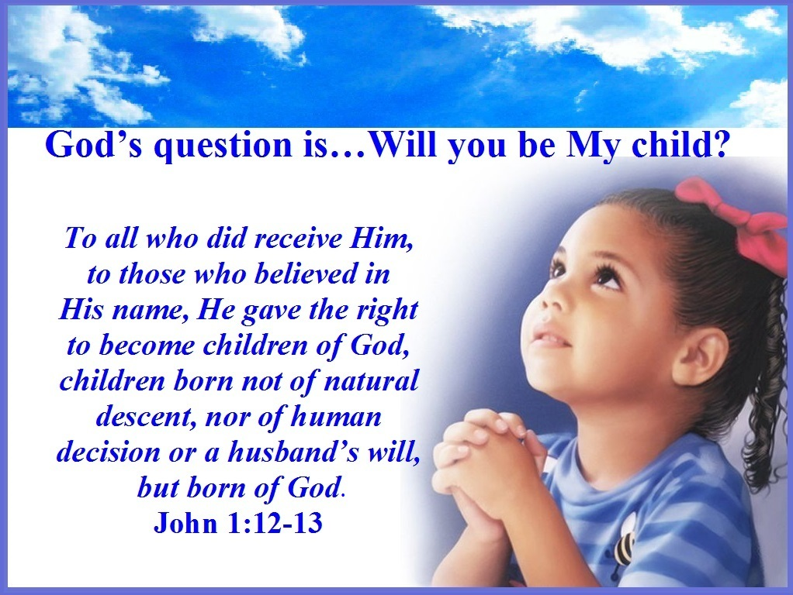
約翰福音1:12-13「凡接待他的，就是信他名的人，他就賜他們權柄，做神的兒女。這等人不是從血氣生的，不是從情慾生的，也不是從人意生的，乃是從神生的。」

Slide 13
B. 等候新郎的教會 Church that waiting for the groom
如施洗約翰：做像先鋒一樣的伴郎 (太3:2, 約3:29-30)
Like John the Baptist : to be the Best Man like a pioneer (Mat 3:2, John 3:29-30)
如西緬、亞拿：忠心禱告，等待彌賽亞再來 (路2:25-37)
Like Simeon, Anna : Praying faithfully, waiting for Messiah to come again (Luke 2:25-37)
如保羅：專心向著標竿直跑 (腓3:13-14, 提後4:7)
Like Paul : press on toward the goal (Philippians 3:13-14, 2 Timothy 4:7)
如大衛：合神心意的人 (詩27:4)
Like David : Man after God’s own heart (Psalm 27:4)
如聰明的童女：預備油等待新郎 (太25:1-13)
Like wise virgins : preparing oil for the bridegroom (Matthew 25:1-13)
- 如智慧人：能辨明時候和定理 (傳8:5)
Like a wise man: know the proper time and procedure. (Ecclesiastes 8:5)

Slide 14
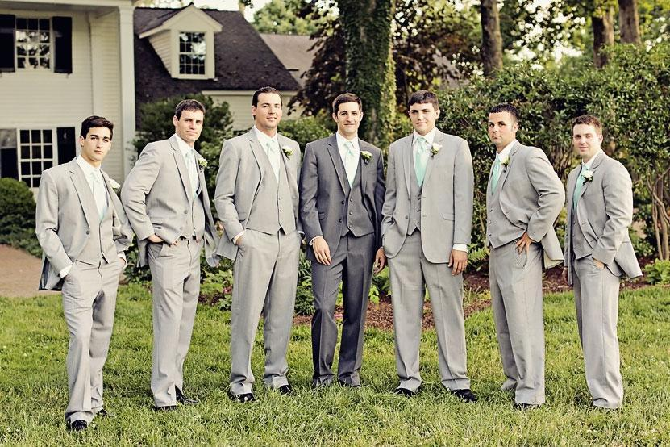
如施洗約翰：做像先鋒一樣的伴郎 (約3:29-30) Like John the Baptist : to be the Best Man like a pioneer (John 3:29-30)

Slide 15
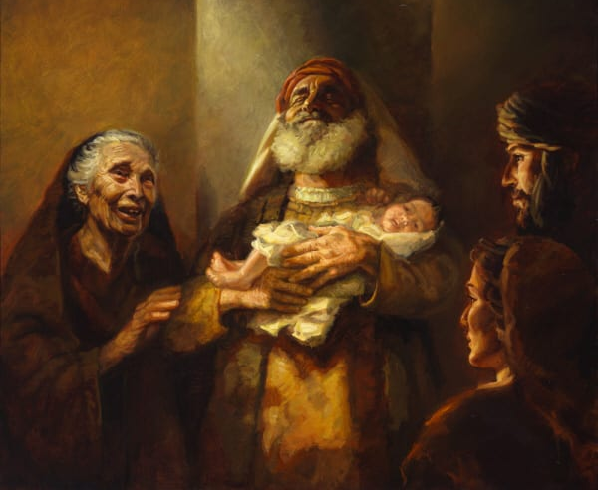
如西緬、亞拿：忠心禱告，等待彌賽亞再來 (路Luke 2:25-37) Like Simeon, Anna : Pray faithfully, wait for Messiah to come again

Slide 16
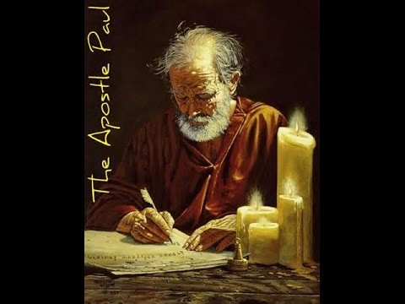
如保羅：專心向著標竿直跑 (提後4:7) Like Paul : press on toward the goal (2 Timothy 4:7)

Slide 17
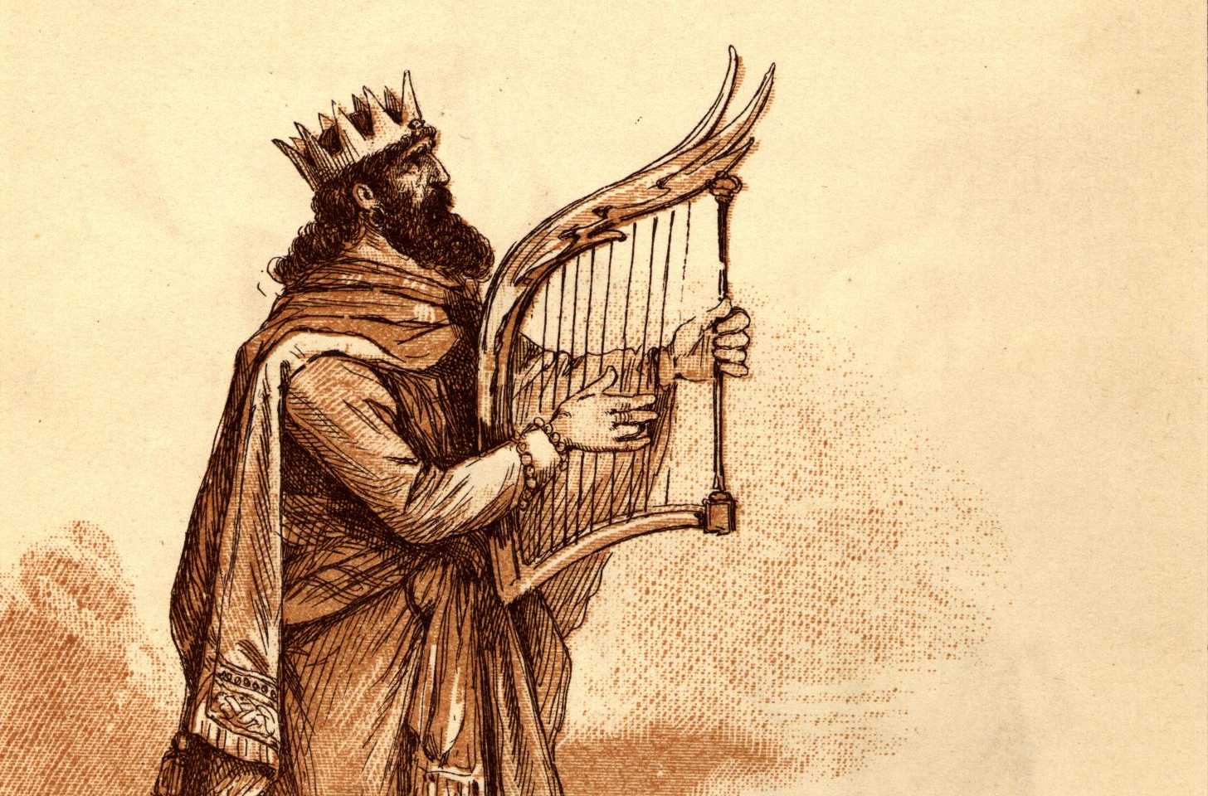
大衛是敬拜神的君王 (詩篇27: 4) King David worship God (Psalm 27:4)

Slide 18
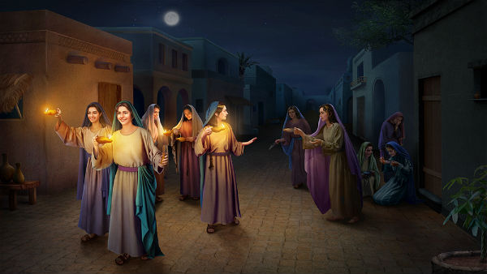
Wise virgins (Matthew 25:1-13) 聰明的童女 (太25:1-13)

Slide 19
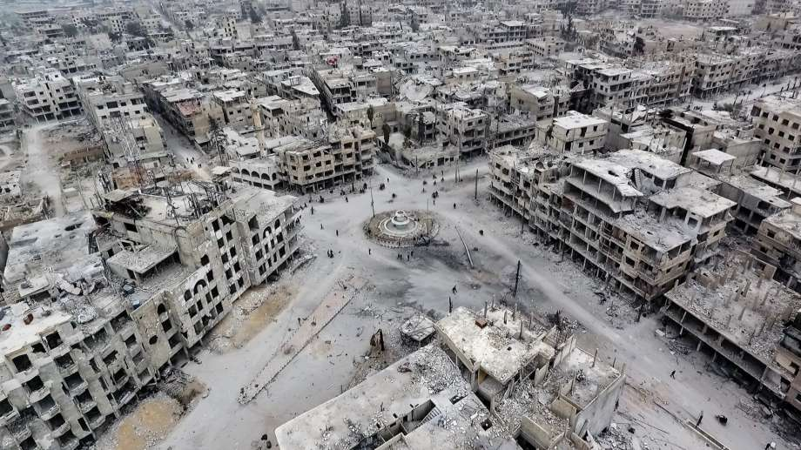
Damascus become ruins (Isaiah 17:1) 大馬色成廢墟 (賽17:1)

Slide 20
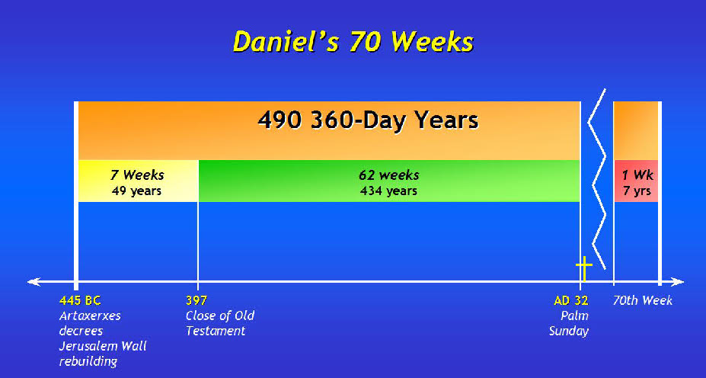
但以理書中的70個7 (但 9:24-27) (Daniel 9:24-27)

Slide 21
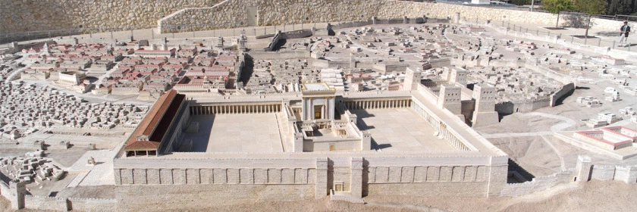
Building the 3rd temple 建立第三聖殿

Slide 22
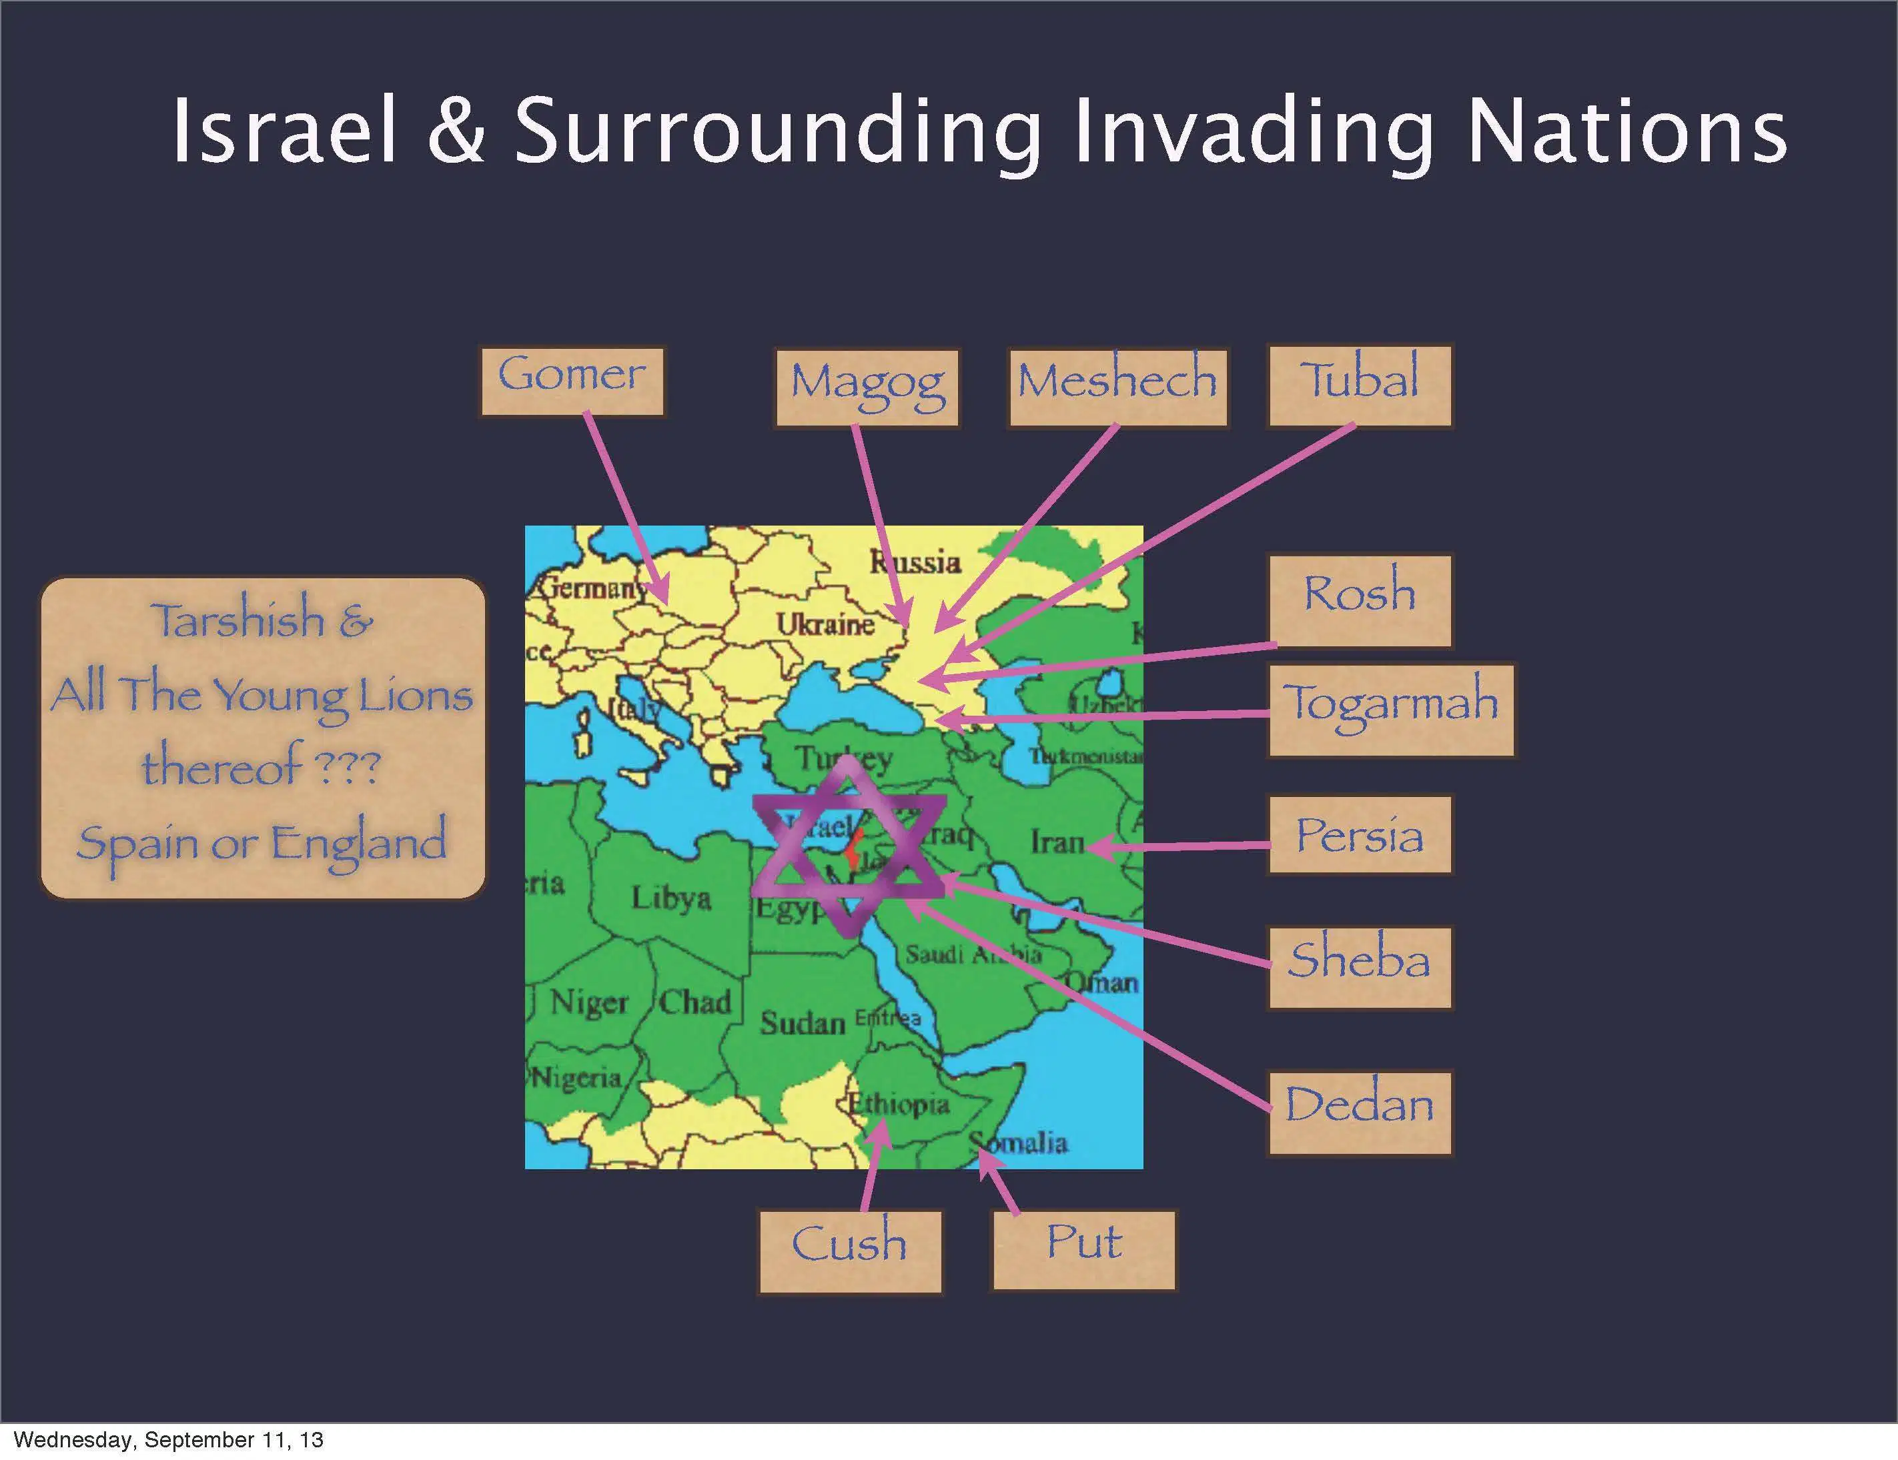
Ezekiel 38 以西結書 38章
土耳其 Turkey
敘利亞 Syria
伊朗 Iran
蘇聯 Russia

Slide 23
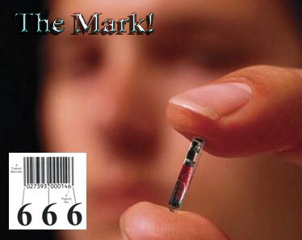
666 Mark of beast (Rev. 13:16-18) 666 獸印 (啟13:16-18)

Slide 24
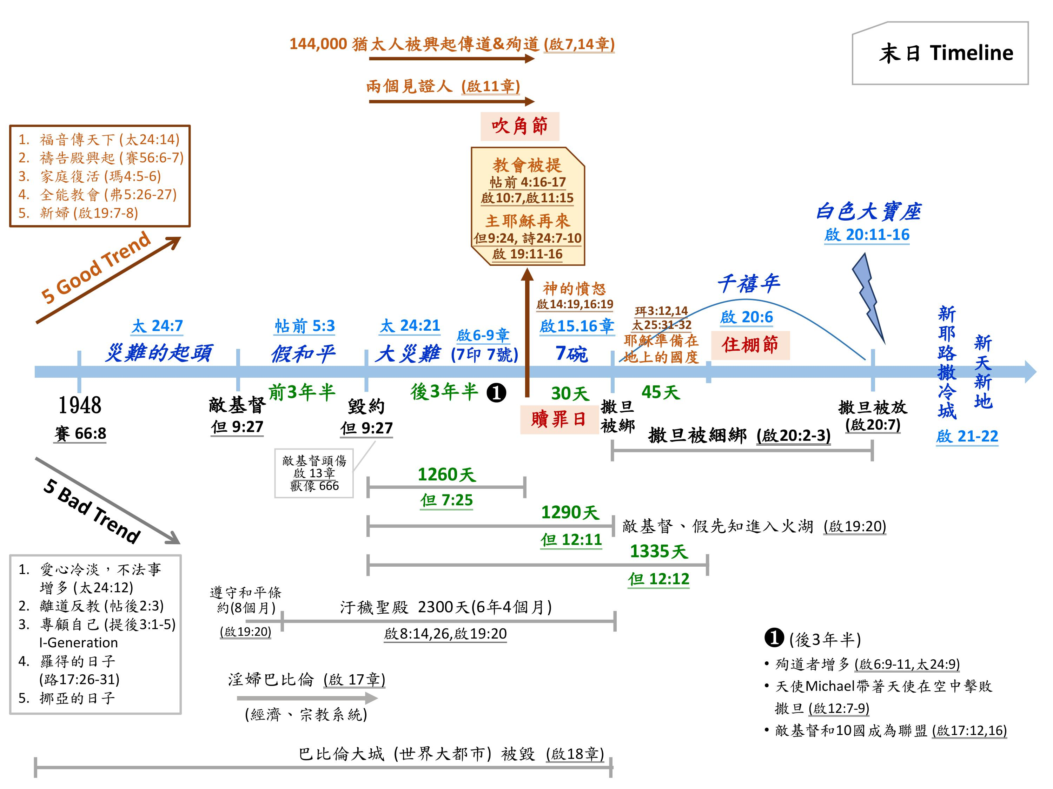

Slide 25
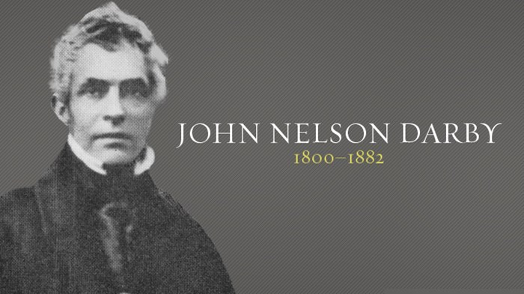
Pre-rapture founder 災前被提的提出者

Slide 26
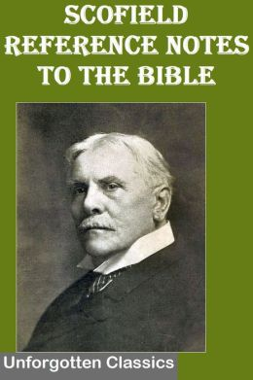
Cyrus Scofield 把災前被提寫成書 流傳到世界各地

Slide 27
C. 彼此相愛接納的教會 Church that loves each other
是一個用心悔改、看別人比自己強的教會 (腓2:3)
Is a church that repents and in humility value others above yourselves (Philippians 2:3)
努力切實活出愛的真諦的教會 (林前13:4-8, 約壹4:16, 弗4:15)
Is a church who works hard to live out to the essence of love (1 Corinthians 13:4-8, 1 John 4:16, Ephesians 4:15)
是一個用神的愛、來遮蓋許多罪的教會 (彼前4:8, 約20:23)
Is a church that cover multitude of sins by God's love (1 Peter 4:8, John 20:23)
彼此饒恕的教會 (西3:12-13)
Is a church that forgives each other (Ephesians 4:31-32)
彼此幫助、扶持軟弱、貧窮的肢體，常常覺得在愛裡虧欠人的教會 (羅13:8)
Is a church that helps each other, supports weakness, and accept the continuing debt to love one another (Romans 13:8)

Slide 28
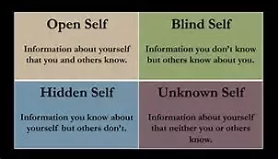
Value others above yourselves (Philippians 2:3) 看別人比自己強 (腓2:3)

Slide 29

Learn how to love (1 Cor 13) 學習如何去愛 (林前13章)

Slide 30

愛能遮蓋許多的罪 (彼前4:8) Love covers multiple of sins (1 Peter 4:8)

Slide 31
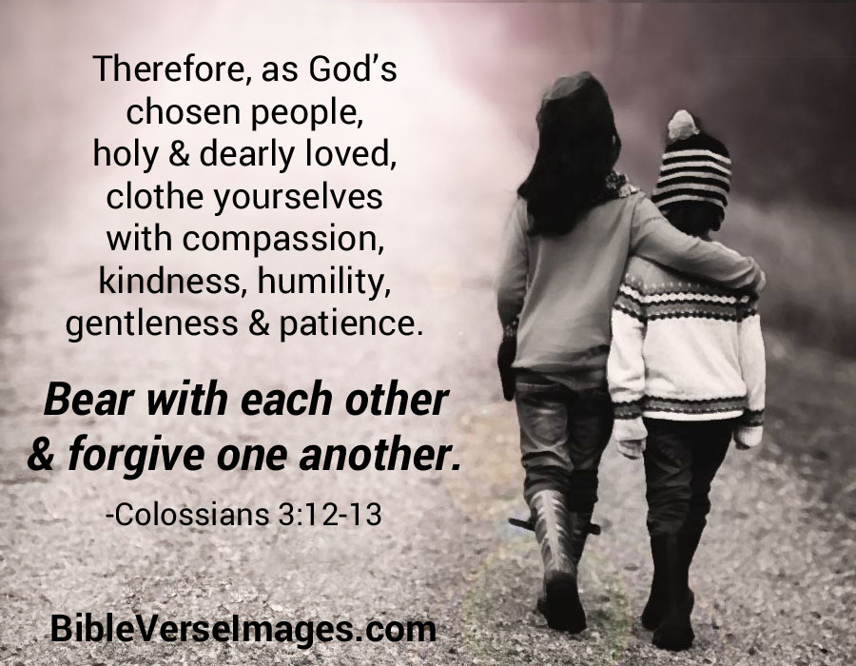
Forgives each other (Ephesians 4:31-32) 彼此饒恕 (西3:12-13)

Slide 32
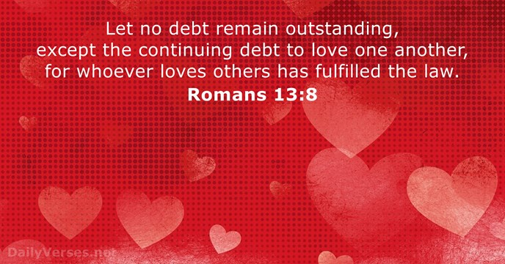
羅馬書 13:8 「凡事都不可虧欠人，惟有彼此相愛要常以為虧欠，因為愛人的就完全了律法。」

Slide 33
D. 站在真理上的教會 Church standing on the truth
不會向偶像跪拜和低頭的教會，如同但以理和他三個朋友 (但3,6章)
A church does not serve and worship other gods, like Daniel and his three friends (Daniel 3, 6)
不妥協、不離道反教的教會 (帖後2:3)
An uncompromising, non-rebellious church (2 Thessalonians 2:3)
在這個邪惡淫亂的世代，耐心專心傳道的教會 (提後4:2)
In this evil and adulterating generation, patiently and faithfully preach (2 Tim 4:2)
有分辨異端的智慧和啓示的靈 (弗1:17)
The spirit of wisdom and revelation to distinguish heresy (Ephesians 1:17)
發出亮光的金燈台 (啟1:20) A golden lampstand that shines light (Revelation 1:20)
① 過分別為聖的生活 Living a sanctified life
② 指示世人天堂路、地獄門 Instruct the world the road to paradise and hell

Slide 34
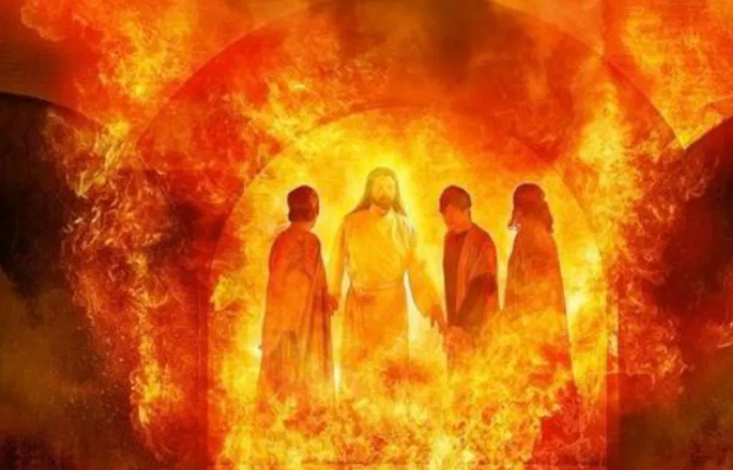
Daniel and his three friends 但以理和他的三個朋友

Slide 35

跟隨神；而非跟隨世界 (弗Ephesians 6:13)

Slide 36
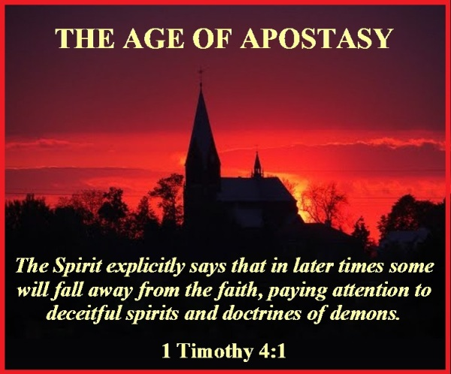
提前 4:1 「聖靈明說，在後來的時候，必有人離棄真道，聽從那引誘人的邪靈和鬼魔的道理。」

Slide 37
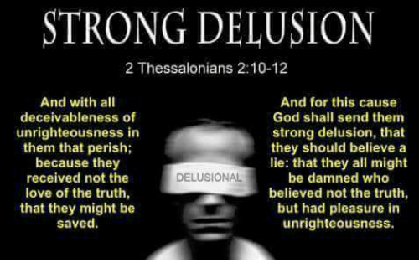
帖後2:10-12 「並且在那沉淪的人身上行各樣出於不義的詭詐；因他們不領受愛真理的心，使他們得救。故此，神就給他們一個生發錯誤的心，叫他們信從虛謊，使一切不信真理、倒喜愛不義的人都被定罪。」

Slide 38
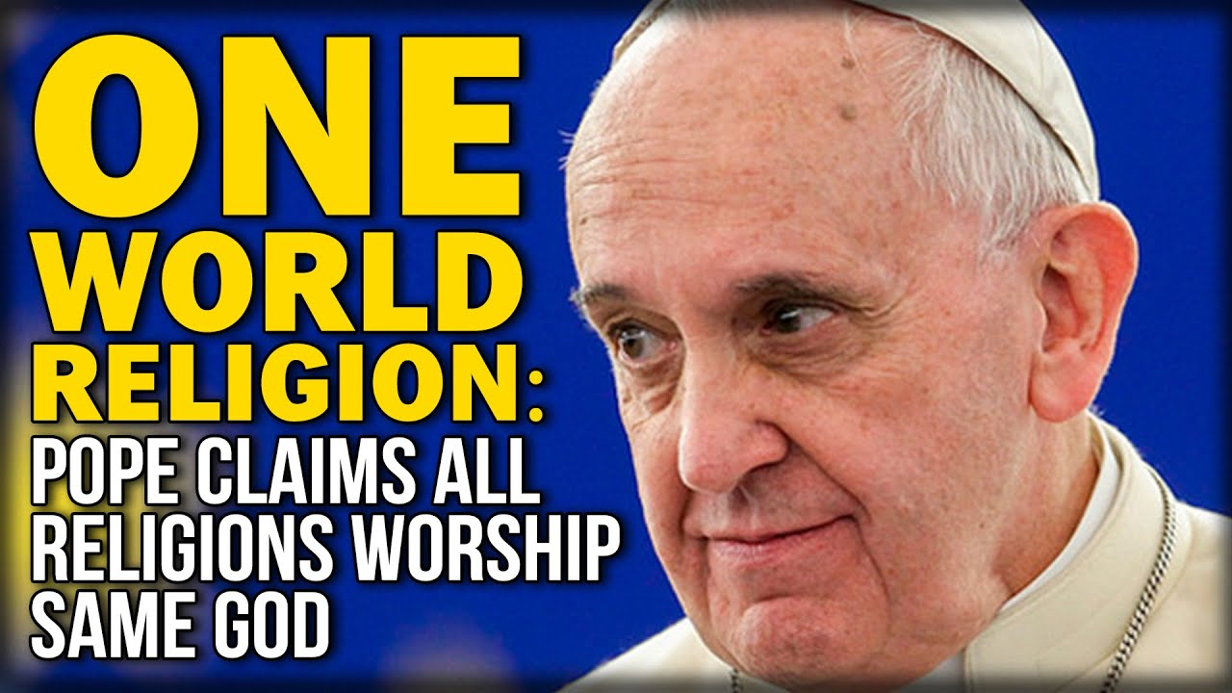
Pope Francis claim, there are many ways to God 教皇Francis提倡：有很多種方法可以進天國

Slide 39

耶穌說：「我就是道路、真理、生命；若不藉著我，沒有人能到父那裡去。」(約14:6)

Slide 40
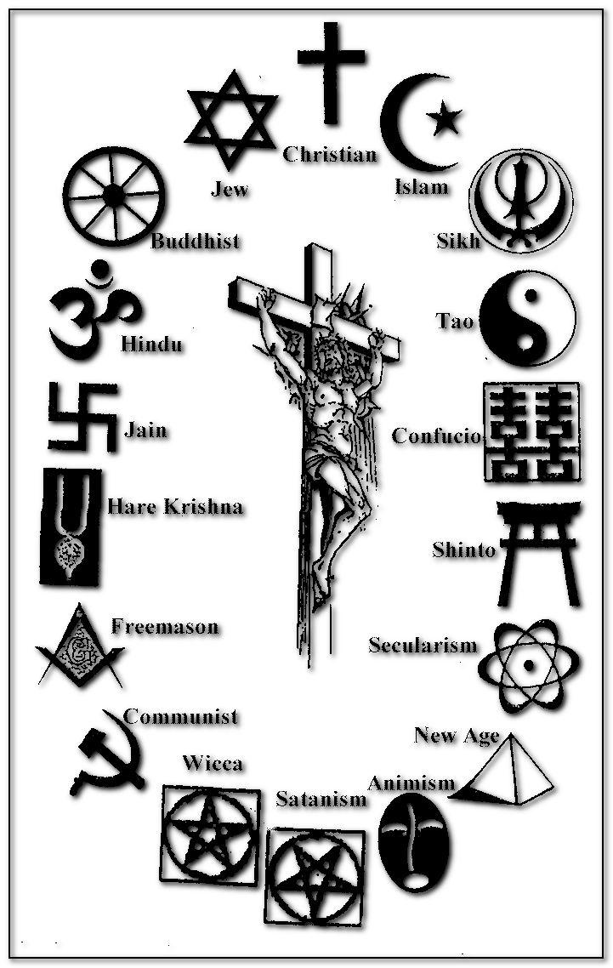
Symbols of Multiple Religions, one love, multiple ways 代表世界上各種宗教

Slide 41


URL : United Religions Initiative 世界聯合宗教組織

Slide 42
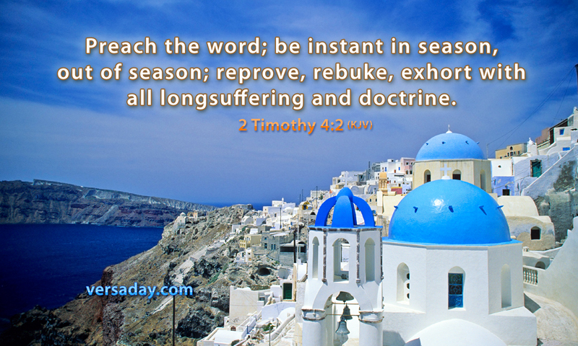
得時不得時，都要傳道 (提後4:2-3)

Slide 43
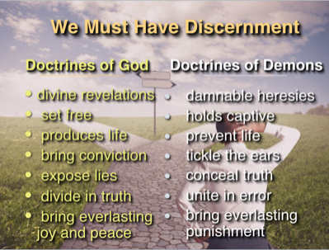
We must have discernment 我們該知道如何分辨

Slide 44
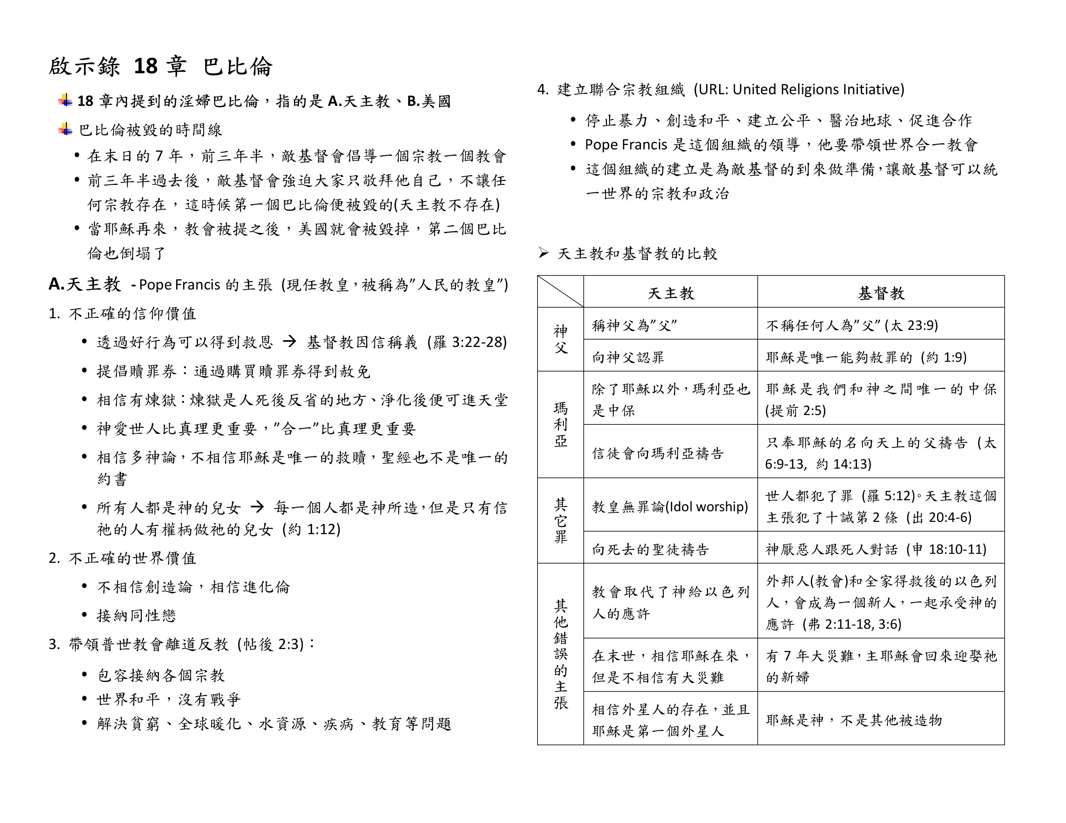

Slide 45
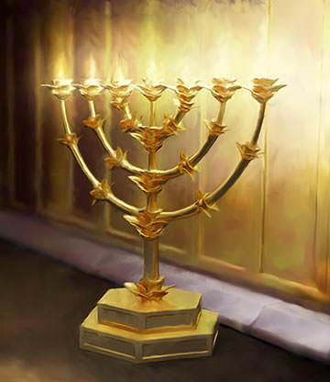
Golden lampstand that shines (Revelation 1:20) 發出亮光的金燈台 (啟1:20)

Slide 46

Living a sanctified life 過分別為聖的生活

Slide 47

耶穌說：我去是為你們預備地方 (約14:2)

Slide 48
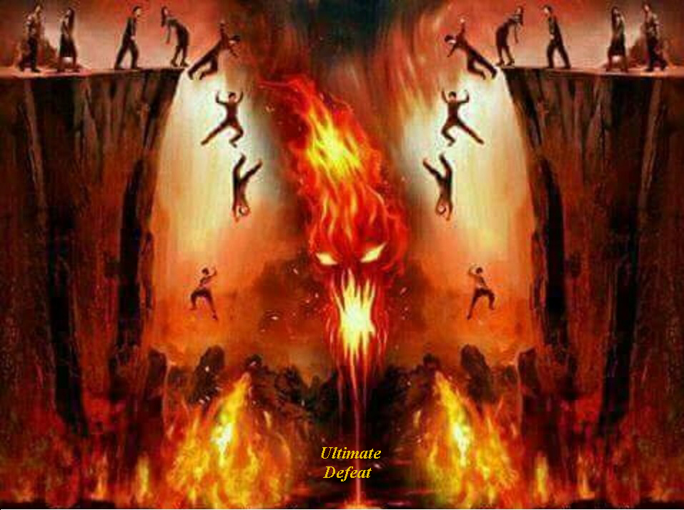
Hell： into the eternal fire prepared for the devil and his angels (Matthew 25:41)
地獄：進入那為魔鬼和他的使者所預備的永火裡去！ (太25:41)

Slide 49
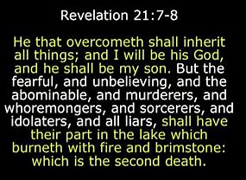
Who cannot go to heaven? 誰不能進天堂 (啟21:7-8)
7 得勝的，必承受這些為業：我要作他的神，他要做我的兒子。8 惟有膽怯的、不信的、可憎的、殺人的、淫亂的、行邪術的、拜偶像的和一切說謊話的，他們的份就在燒著硫磺的火湖裡；這是第二次的死。

Slide 50
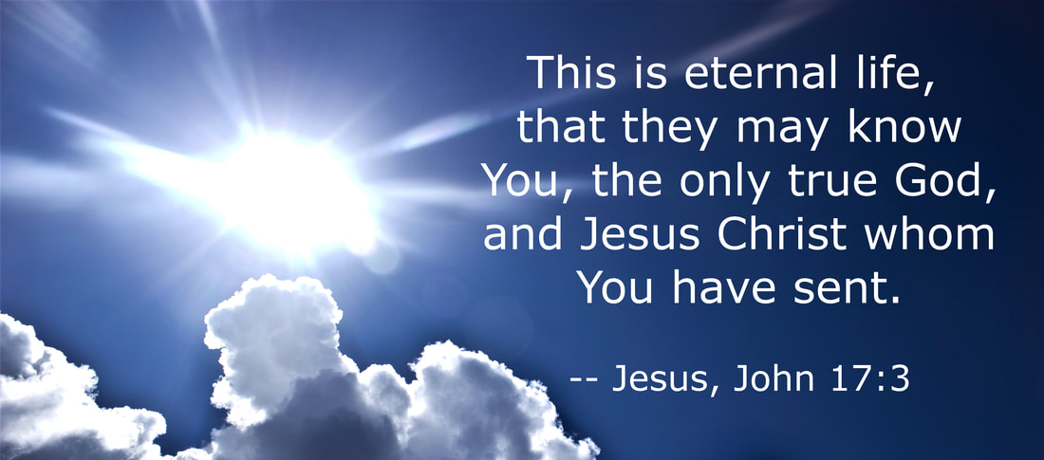
What is eternal life? 甚麼是永生？(約17:3)
認識你獨一的真神，並且認識你所差來的耶穌基督，這就是永生。

Slide 51
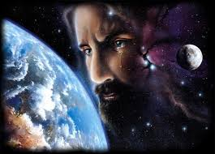
Not wanting anyone to perish, but everyone to come to repentance (2 Peter 3:9)
不願有一人沉淪，乃願人人都悔改。(彼後3:9)

Slide 52
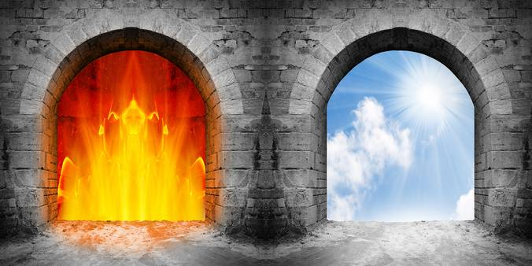
Gate of Heaven and Hell (Rev 21:21, Mat 25:41) 天堂門(啟21:21) 地獄門(太25:41)

Slide 53

因為耶穌，我的名字被記在生命冊上

Slide 54
E. 會打仗的教會 Church that able to fight
不怕苦和痛、不怕窮和疾病、不怕分離和死亡 (啟12:11)
Not afraid of bitterness and pain, not afraid of poverty and disease, not afraid of separation and death (Revelation 12:11)
神國中的大能勇士，如同大衛打敗歌利亞 (撒上17:43-54)
The mighty warrior in the kingdom of God, as David defeated Goliath (1 Samuel 17:43-54)
與主同工的教會 (可16:16-20)
Church works with the Lord (Mark 16:16-20)
不拿666獸印、不拜獸像的教會 (啟13章)
Church do not take 666 the mark of the beast, not worship the image of the beast (Revelation 13)
百戰百勝，得勝者的軍隊 (羅8:35-39)
The army of the victors (Romans 8:35-39)

Slide 55
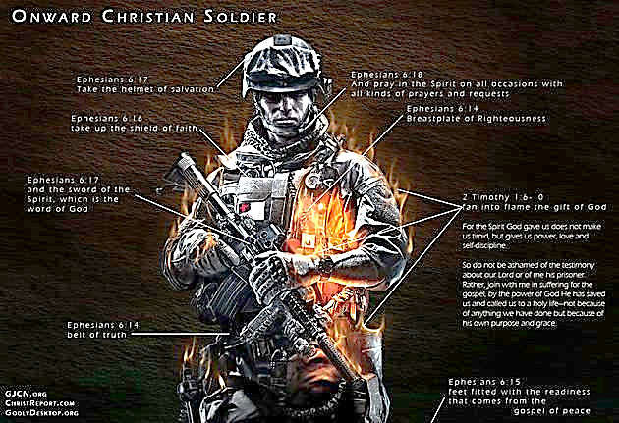
Put on the full armor of God (Ephesians 6:10-18) 穿上神所賜的全副軍裝 (弗6:10-18)

Slide 56
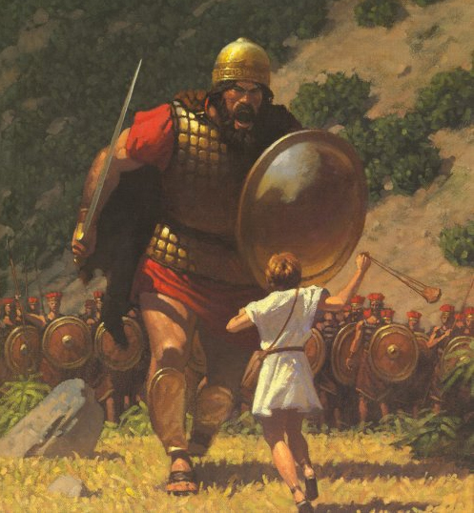
David and Goliath (1 Samuel 17:43-54) 大衛和歌利亞 (撒上 17:43-54)

Slide 57
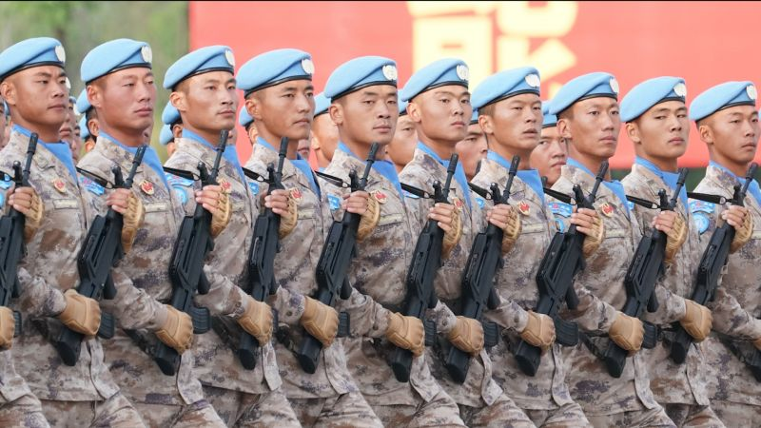
Works with the Lord (Mark 16:16-20) 與主同工 (可16:16-20)
20 門徒出去，到處宣傳福音。主和他們同工，用神蹟隨著，證實所傳的道。
20 Then the disciples went out and preached everywhere, and the Lord worked with them and confirmed his word by the signs that accompanied it.

Slide 58
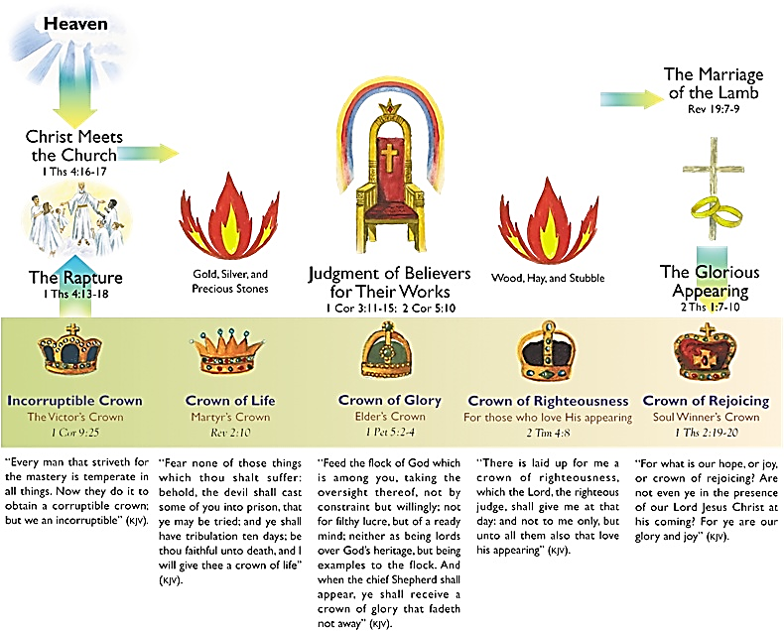
Crowns for heavenly reward 五種冠冕

Slide 59
666 Mark of beast (Rev. 13:16-18) 666 獸印 (啟13:16-18)

Slide 60
誰能使我與神的愛隔絕
35誰能使我們與基督的愛隔絕呢？難道是患難嗎？是困苦嗎？是逼迫嗎？是飢餓嗎？是赤身露體嗎？是危險嗎？是刀劍嗎？ 36如經上所記：「我們為你的緣故終日被殺；人看我們如將宰的羊。」 37然而，靠著愛我們的主，在這一切的事上已經得勝有餘了。 38因為我深信無論是死，是生，是天使，是掌權的，是有能的，是現在的事，是將來的事， 39是高處的，是低處的，是別的受造之物，都不能叫我們與神的愛隔絕；這愛是在我們的主基督耶穌裡的。(羅8:35-39)
35 Who shall separate us from the love of Christ? Shall trouble or hardship or persecution or famine or nakedness or danger or sword? 36 As it is written : “For your sake we face death all day long; we are considered as sheep to be slaughtered.” 37 No, in all these things we are more than conquerors through him who loved us. 38 For I am convinced that neither death nor life, neither angels nor demons,[b] neither the present nor the future, nor any powers, 39 neither height nor depth, nor anything else in all creation, will be able to separate us from the love of God that is in Christ Jesus our Lord. (Romans 8:35-39)

Slide 61
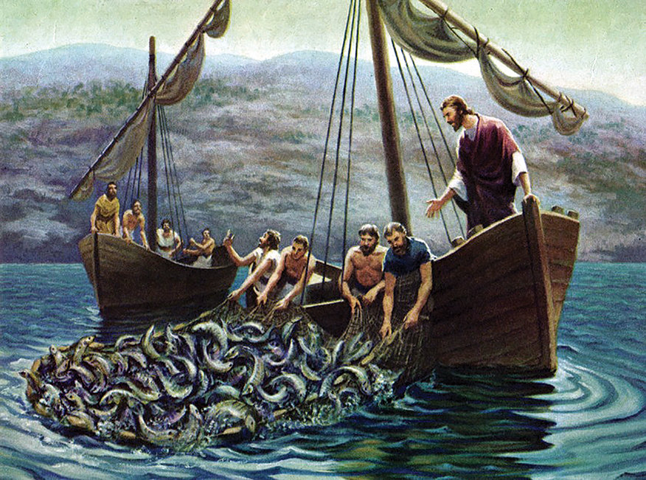
耶穌要呼召同工一起收割莊稼 (約15:15-16)
15 以後我不再稱你們為僕人，因僕人不知道主人所做的事。我乃稱你們為朋友；因我從我父所聽見的，已經都告訴你們了。16 不是你們揀選了我，是我揀選了你們，並且分派你們去結果子，叫你們的果子常存，使你們奉我的名，無論向父求什麼，他就賜給你們。
15 I no longer call you servants, because a servant does not know his master's business. Instead, I have called you friends, for everything that I learned from my Father I have made known to you. 16 You did not choose me, but I chose you and appointed you so that you might go and bear fruit-fruit that will last-and so that whatever you ask in my name the Father will give you.

Slide 62
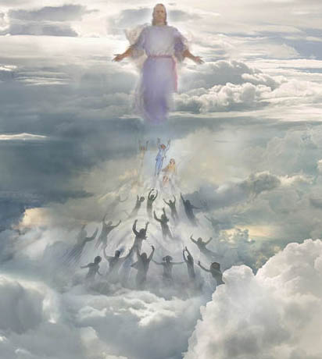
Rapture (4:16-17) 教會被提 (帖前4:16-17)
16 因為主必親自從天降臨，有呼叫的聲音和天使長的聲音，又有神的號吹響；那在基督裡死了的人必先復活。 17 以後我們這活著還存留的人必和他們一同被提到雲裡，在空中與主相遇。這樣，我們就要和主永遠同在。
16 For the Lord himself will come down from heaven, with a loud command, with the voice of the archangel and with the trumpet call of God, and the dead in Christ will rise first. 17 After that, we who are still alive and are left will be caught up together with them in the clouds to meet the Lord in the air. And so we will be with the Lord forever.

Slide 63
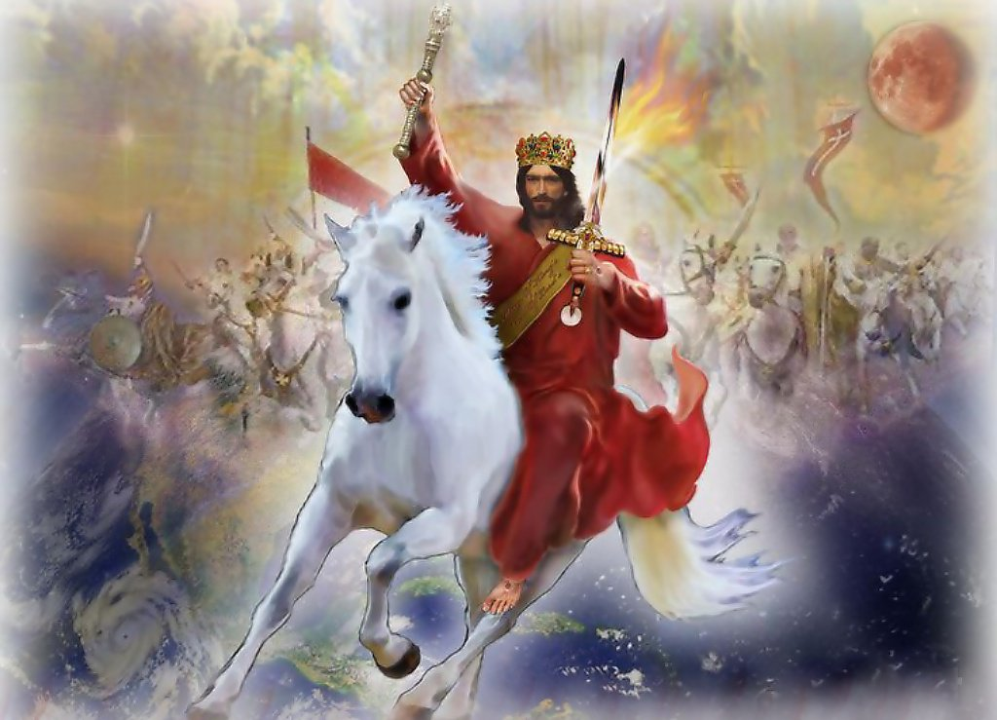
Jesus Christ return as King of King Rev (19:11-16) 主耶穌回來做王 (啟19:11-16)

Slide 64
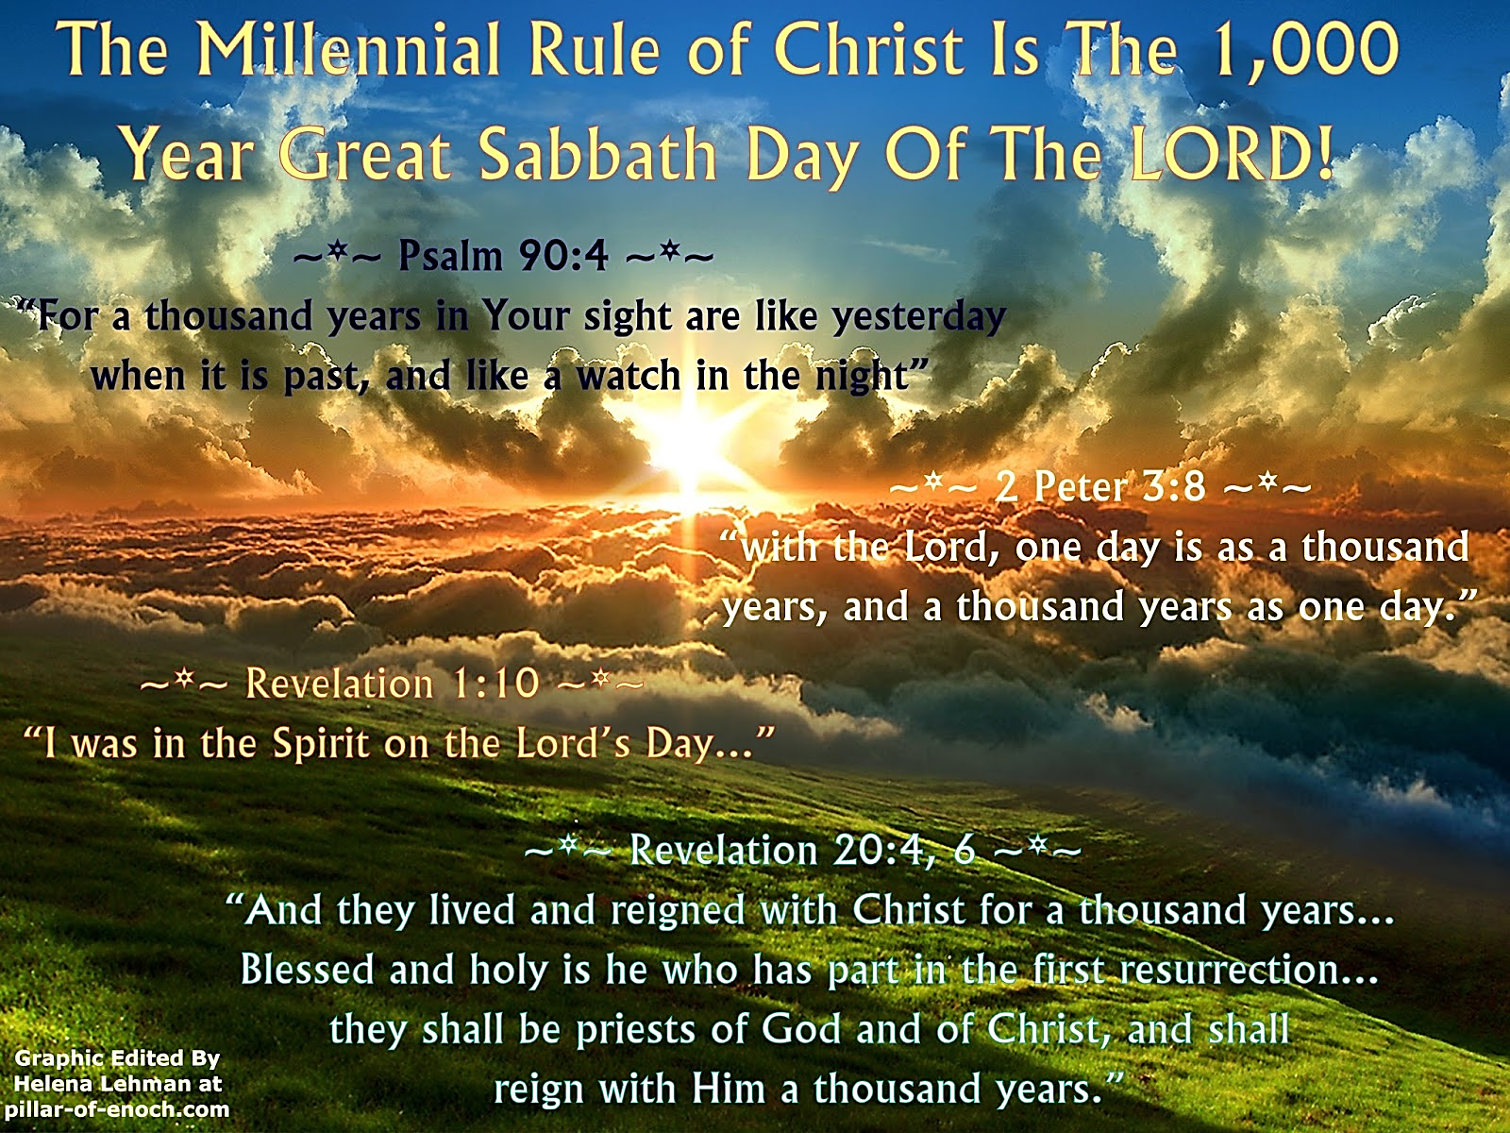
Jesus Christ return as King of King (Rev 19:11-16) 主耶穌回來做王 (啟19:11-16)

Slide 65
以賽亞書60:1「興起，發光！因為你的光已經來到！耶和華的榮耀發現照耀你。」

